Slide 1
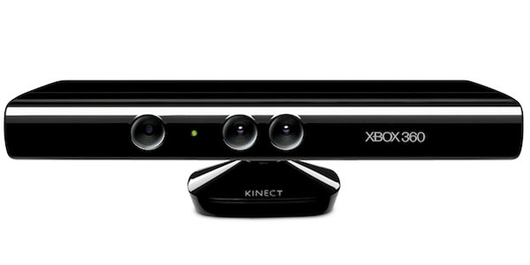
Kinect Workshop
Marco Franssen, Jan Saris
Eindhoven, 9 juni 2011

Slide 2
What will we do tonight
Introducuction
Architecture / Cohesion of projects in the solution
Stuff to think about
Workshop

Slide 3
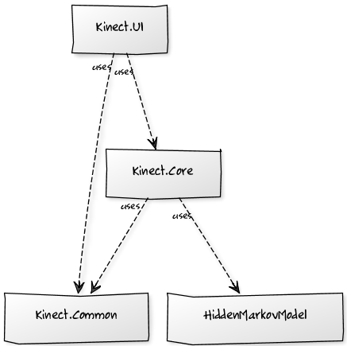
Architecture
Cohesion of the visual studio projects
Demos
Framework
Extensions
Notes:
http://yuml.me/diagram/scruffy;dir:td/class/draw
# Kinect Diagram
[Kinect.Core]uses-.->[HiddenMarkovModel]
[Kinect.Core]uses-.->[Common]
[Kinect.WPF]uses-.->[Common]
[Kinect.WPF]uses-.->[Kinect.Core]

Slide 4
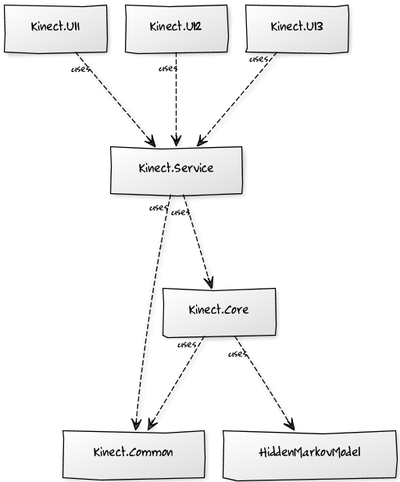
Architecture
Cohesion of the visual studio projects
Demos
Framework
Extensions
Notes:
http://yuml.me/diagram/scruffy;dir:td/class/draw
# Cool UML Diagram
[Kinect.Core]uses-.->[HiddenMarkovModel]
[Kinect.Core]uses-.->[Kinect.Common]
[Kinect.Service]uses-.->[Kinect.Common]
[Kinect.Service]uses-.->[Kinect.Core]
[Kinect.UI3]uses-.->[Kinect.Service]
[Kinect.UI2]uses-.->[Kinect.Service]
[Kinect.UI1]uses-.->[Kinect.Service]

Slide 5
Stuff to think about
Multi-threading, debugging, performance
Multi-threading
Updating User Interface
Debugging your code
Performance
30 fps
Optional chapter number (Arial 10 regular)

Slide 6
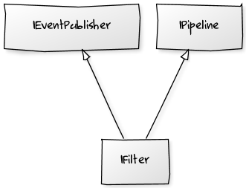

Filters and Gestures
Interfaces
Pipelines
Notes:
# Cool UML Diagram
[IPipeline]^-[IFilter]
[IEventPublisher]^-[IFilter]
# Cool UML Diagram
[User : IEventPublisher]->[MyFilter : IFilter]
[MyFilter : IFilter]->[MyGesture : IPipeline]

Slide 7
Workshop
Hands-on
Part 0:
Installation
Part 1:
Discover MyKinect
Part 2:
Detect User
Read User data
Part 3:
Create a Filter
Create a Gesture
https://github.com/atosorigin/Kinect

Slide 8
For more information please contact: Marco Franssen +31 (0)6 83 62 73 00 marco.franssen@atos.net
Jan Saris +31 (0)6 52 54 22 69 jan.saris@atos.net

